Slide 1

Machine Learning
Logistic Regression
(Classification)
Session 4

Slide 2




Session 4
Content
Review
Classification
Hypothesis Representation
Decision boundary
Cost function
Simplified Cost function And Gradient descent
Advanced optimization
Multiclass classification: One--vs-­-all
Grow Through

Slide 3
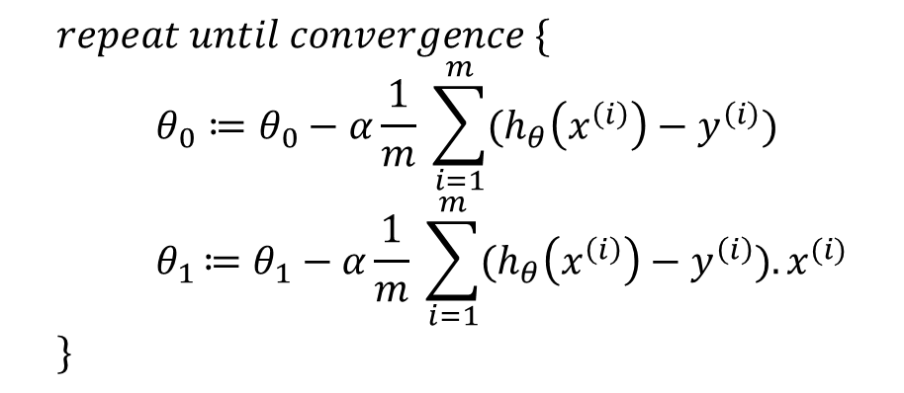
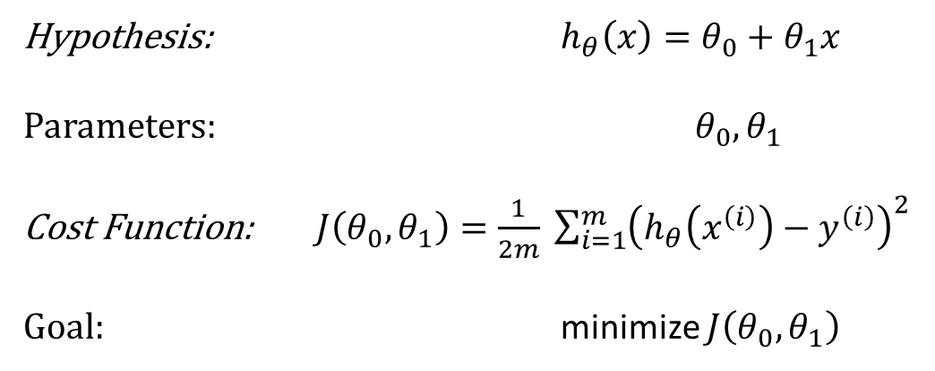
Session 4
Review:
Linear regression model
Gradient descent algorithm
Hypothesis: $h_{θ}\left(x\right)=θ_{0}+θ_{1}x$
Parameters: $θ_{0},θ_{1}$
Cost Function: $J\left(θ_{0},θ_{1}\right)=\frac{1}{2m} \sum_{i=1}^{m}{{\left(h_{θ}\left(x^{\left(i\right)}\right)−y^{\left(i\right)}\right)}^{2}}$
Goal: minimize $J\left(θ_{0},θ_{1}\right)$
$$repeat until convergence \{ \\ θ_{0}≔θ_{0}−α\frac{1}{m} \sum_{i=1}^{m}{(h_{θ}\left(x^{\left(i\right)}\right)−y^{\left(i\right)})} \\ { θ}_{1 }≔θ_{1}−α\frac{1}{m} \sum_{i=1}^{m}{(h_{θ}\left(x^{\left(i\right)}\right)−y^{\left(i\right)}).x^{(i)}} \\ \}$$
Grow Through

Slide 4
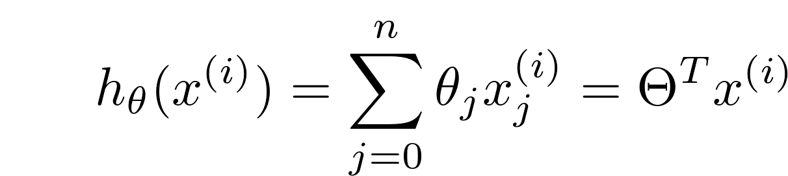
Session 4
Review:
Normal Equation
Grow Through

Slide 5

Session 4
Classification
Examples:
Email: Spam / Not Spam?
Online Transactions: Fraudulent(Yes / No)?
Tumor: Malignant / Benign ?
0: “Negative Class” →Spam
1: “Positive Class” →Not Spam
$$y=\{0, 1\}$$
Grow Through

Slide 6
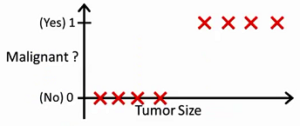
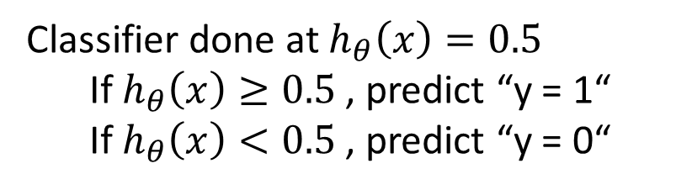
Session 4
Classification
What if ?
0.5
Classifier done at $h_{θ}\left(x\right)=0.5$
If $h_{θ}\left(x\right)≥0.5$ , predict “y = 1“
If $h_{θ}\left(x\right)<0.5$ , predict “y = 0“
Grow Through

Slide 7
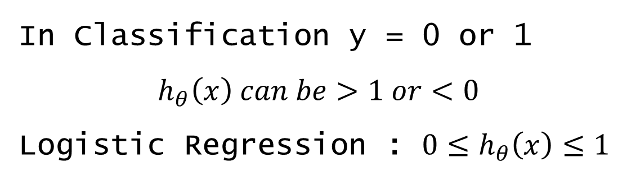
Session 4
Classification
In Classification y = 0 or 1
$$h_{θ}\left(x\right) can be>1 or<0$$
Logistic Regression : $0≤h_{θ}\left(x\right)≤1$
Grow Through

Slide 8
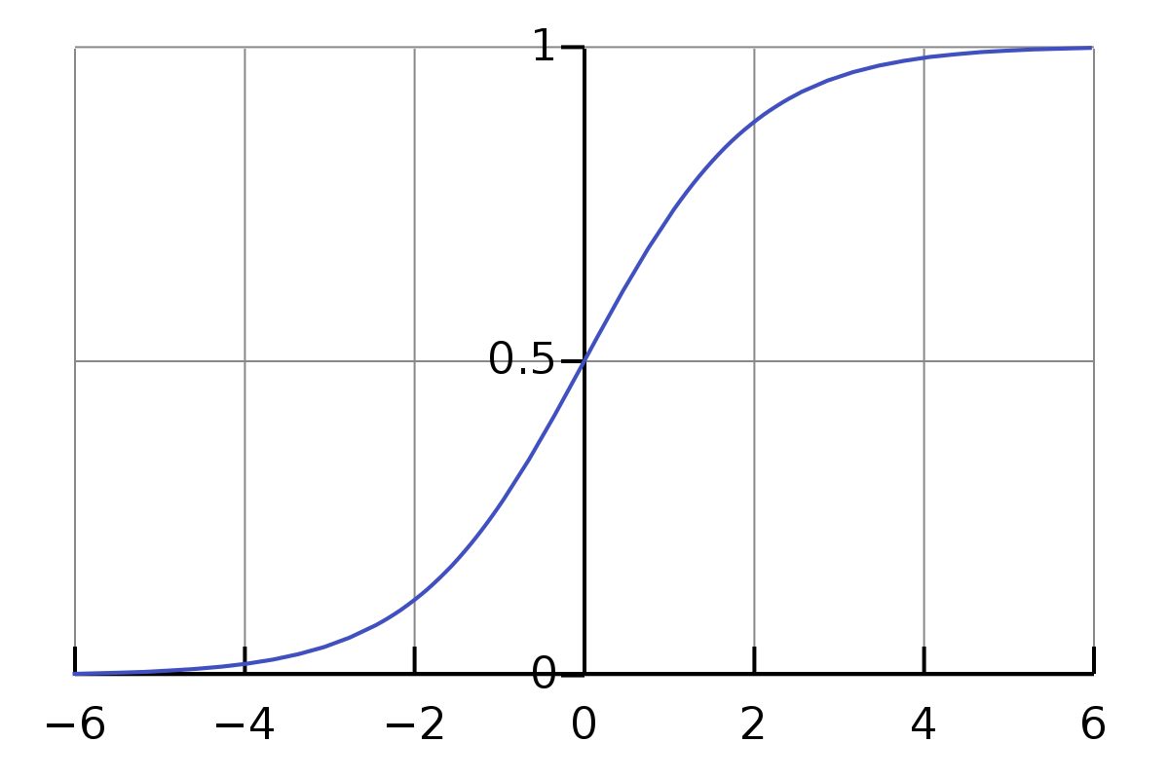
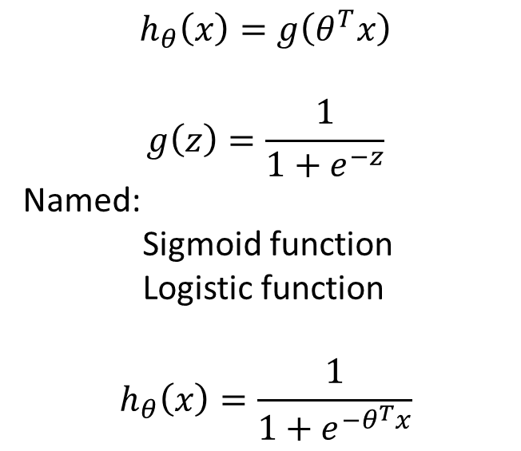
Session 4
Hypothesis Representation
Logistic Regression model
$$h_{θ}\left(x\right)=g\left(θ^{T}x\right)$$
$$g\left(z\right)=\frac{1}{1+e^{−z}}$$
Named:
Sigmoid function
Logistic function
$$h_{θ}\left(x\right)=\frac{1}{1+e^{−θ^{T}x}}$$
Sigmoid function
Grow Through

Slide 9
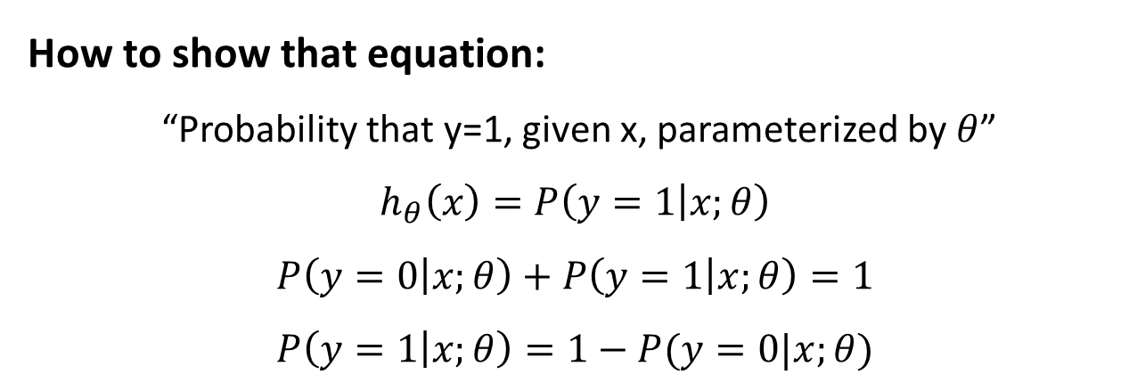
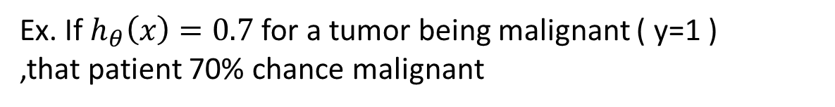
Session 4
Hypothesis Representation
Interpretation of Hypothesis representation :
Ex. If $h_{θ}\left(x\right)=0.7$ for a tumor being malignant ( y=1 )
,that patient 70% chance malignant
How to show that equation:
“Probability that y=1, given x, parameterized by $θ$”
$$h_{θ}\left(x\right)=P\left(y=1 | x;θ\right)$$
$$P\left(y=0 | x;θ\right)+P\left(y=1 | x;θ\right)=1$$
$$P\left(y=1 | x;θ\right)=1−P(y=0|x;θ)$$
Grow Through

Slide 10
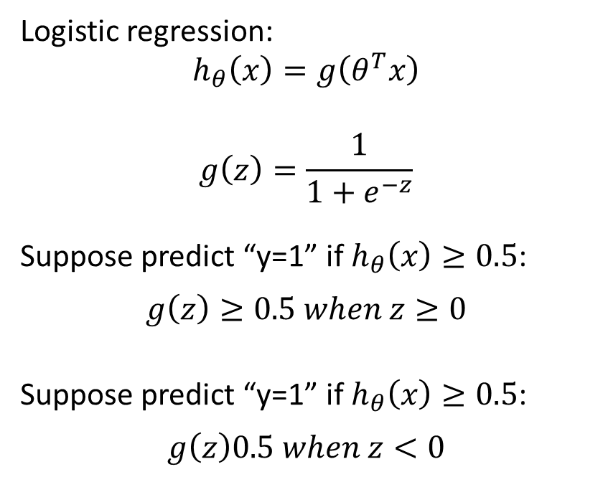
Session 4
Decision boundary
Logistic regression: $$h_{θ}\left(x\right)=g\left(θ^{T}x\right)$$
$$g\left(z\right)=\frac{1}{1+e^{−z}}$$
Suppose predict “y=1” if $h_{θ}\left(x\right)≥0.5$:
$$g\left(z\right)≥0.5 when z≥0$$
Suppose predict “y=1” if $h_{θ}\left(x\right)≥0.5$:
$$g\left(z\right)0.5 when z<0$$
Z
Grow Through

Slide 11
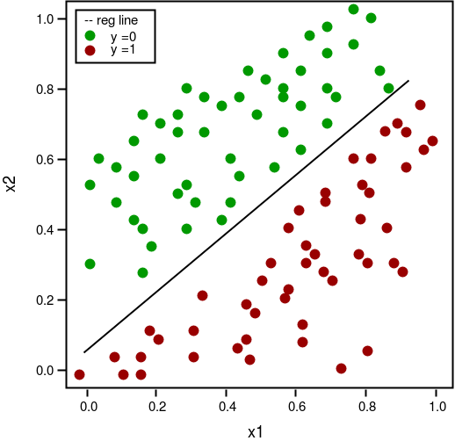
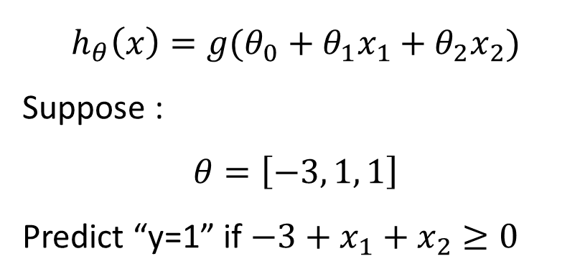
Session 4
Decision boundary
$$h_{θ}\left(x\right)=g(θ_{0}+θ_{1}x_{1}+θ_{2}x_{2})$$
Suppose :
$$θ=\left[−3, 1, 1\right]$$
Predict “y=1” if $−3+x_{1}+x_{2}≥0$
Grow Through

Slide 12
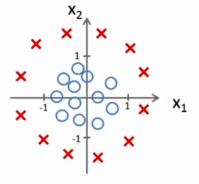
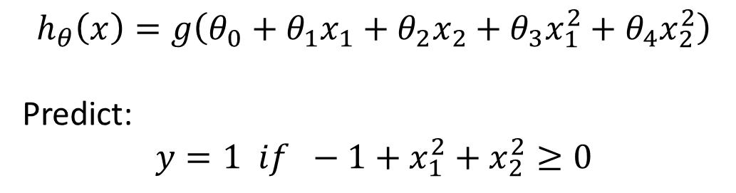
Session 4
Decision boundary
Non-linear decision boundary
$$h_{θ}\left(x\right)=g\left(θ_{0}+θ_{1}x_{1}+θ_{2}x_{2}+θ_{3}x_{1}^{2}+θ_{4}x_{2}^{2}\right)$$
Predict:
$$y=1 if −1+x_{1}^{2}+x_{2}^{2}≥0$$
$$h_{θ}\left(x\right)=g\left(θ_{0}+θ_{1}x_{1}+θ_{2}x_{2}+θ_{3}x_{1}^{2}+θ_{4}x_{1}^{2}x_{2}+θ_{5}x_{1}^{2}x_{2}^{2}+…\right)$$
Grow Through

Slide 13
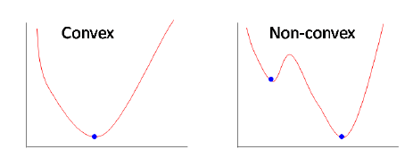
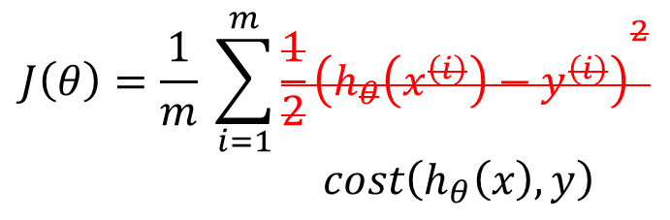
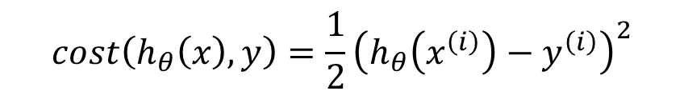
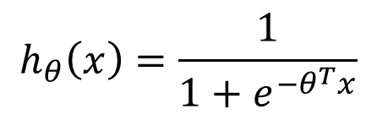
Session 4
Cost function
$$J\left(θ\right)=\frac{1}{m} \sum_{i=1}^{m}{{\frac{1}{2}\left(h_{θ}\left(x^{\left(i\right)}\right)−y^{\left(i\right)}\right)}^{2}}$$
$$cost\left(h_{θ}\left(x\right), y\right)$$
$$h_{θ}\left(x\right)=\frac{1}{1+e^{−θ^{T}x}}$$
$$cost\left(h_{θ}\left(x\right), y\right)=\frac{1}{2}{\left(h_{θ}\left(x^{\left(i\right)}\right)−y^{\left(i\right)}\right)}^{2}$$
Problem!
Grow Through

Slide 14
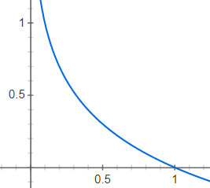

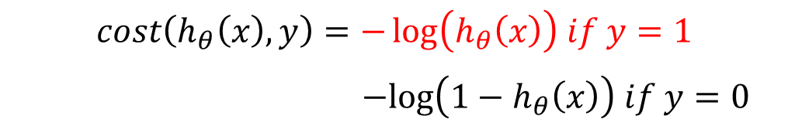
Session 4
Cost function
$$cost\left(h_{θ}\left(x\right), y\right)=−\log\left(h_{θ}\left(x\right)\right) if y=1$$
$$−log\left(1−h_{θ}\left(x\right)\right) if y=0$$
$$Cost =0 if y=1, h_{θ}\left(x\right)=1$$
$$when h_{θ}\left(x\right)=0 →cost=∞$$
Grow Through

Slide 15
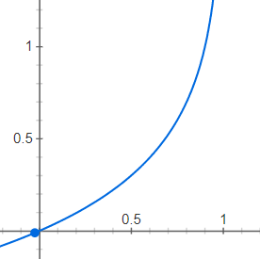

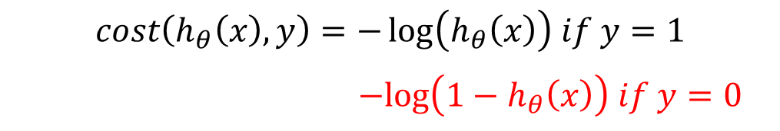
Session 4
Cost function
$$cost\left(h_{θ}\left(x\right), y\right)=−\log\left(h_{θ}\left(x\right)\right) if y=1$$
$$−log\left(1−h_{θ}\left(x\right)\right) if y=0$$
$$Cost =0 if y=0, h_{θ}\left(x\right)=0$$
$$when h_{θ}\left(x\right)=1 →cost=∞$$
Grow Through

Slide 16
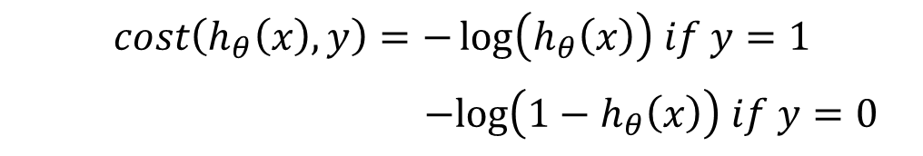
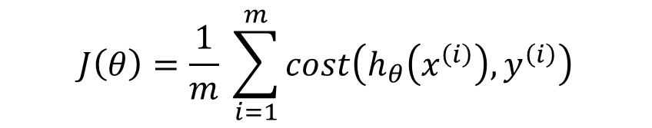
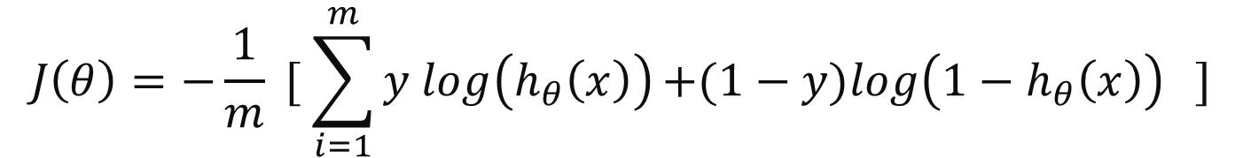
Session 4
Simplified Cost function And Gradient descent
$$J\left(θ\right)=\frac{1}{m} \sum_{i=1}^{m}{cost\left(h_{θ}\left(x^{\left(i\right)}\right),y^{\left(i\right)}\right)}$$
$$cost\left(h_{θ}\left(x\right), y\right)=−\log\left(h_{θ}\left(x\right)\right) if y=1$$
$$−log\left(1−h_{θ}\left(x\right)\right) if y=0$$
$$cost\left(h_{θ}\left(x\right), y\right)=−y log\left(h_{θ}\left(x\right)\right)−(1−y)log\left(1−h_{θ}\left(x\right)\right)$$
$$J\left(θ\right)=−\frac{1}{m} [ \sum_{i=1}^{m}{y log\left(h_{θ}\left(x\right)\right)+(1−y)log\left(1−h_{θ}\left(x\right)\right) }]$$
Grow Through

Slide 17
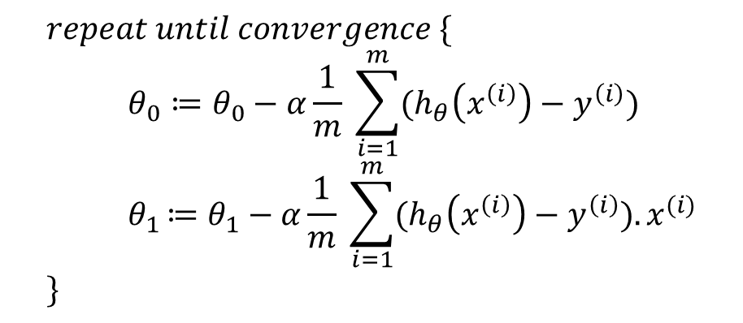
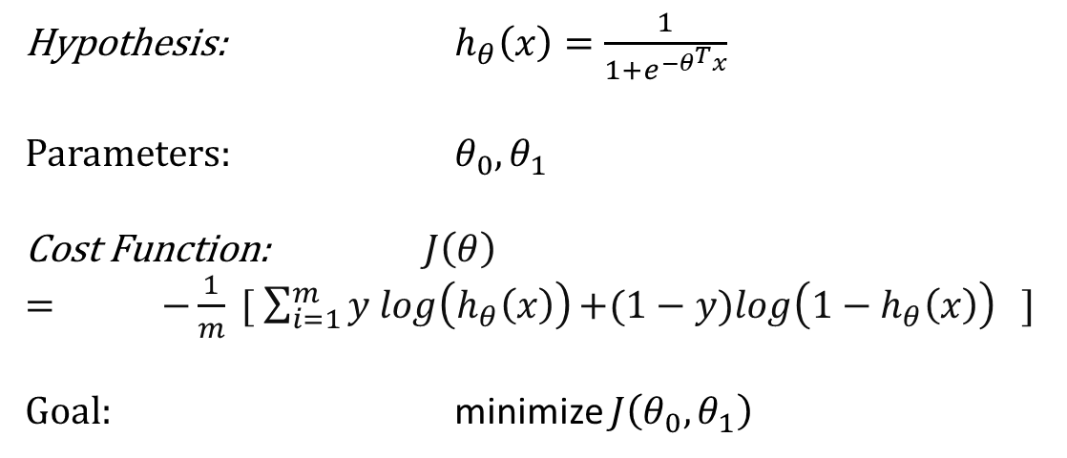
Session 4
All Equations:
Logistic regression model
Gradient descent algorithm
Hypothesis: $h_{θ}\left(x\right)=\frac{1}{1+e^{−θ^{T}x}}$
Parameters: $θ_{0},θ_{1}$
Cost Function: $J\left(θ\right)= −\frac{1}{m} [ \sum_{i=1}^{m}{y log\left(h_{θ}\left(x\right)\right)+(1−y)log\left(1−h_{θ}\left(x\right)\right) }]$
Goal: minimize $J\left(θ_{0},θ_{1}\right)$
$$repeat until convergence \{ \\ θ_{0}≔θ_{0}−α\frac{1}{m} \sum_{i=1}^{m}{(h_{θ}\left(x^{\left(i\right)}\right)−y^{\left(i\right)})} \\ { θ}_{1 }≔θ_{1}−α\frac{1}{m} \sum_{i=1}^{m}{(h_{θ}\left(x^{\left(i\right)}\right)−y^{\left(i\right)}).x^{(i)}} \\ \}$$
Looks Identical to Linear Regression
Grow Through

Slide 18
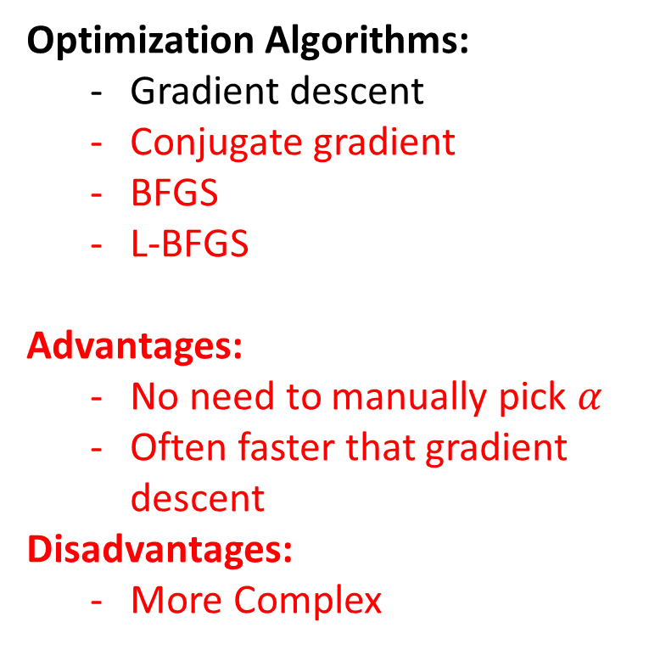
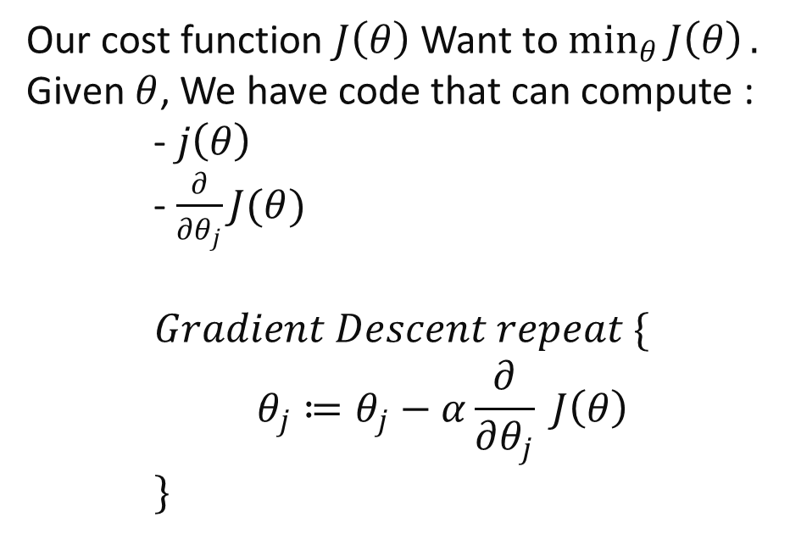
Session 4
Advanced optimization
Optimization Algorithms:
Gradient descent
Conjugate gradient
BFGS
L-BFGS
Advantages:
No need to manually pick $α$
Often faster that gradient descent
Disadvantages:
More Complex
Our cost function $J\left(θ\right)$ Want to $\min_{θ}{J\left(θ\right)}.$
Given $θ$, We have code that can compute :
- $j\left(θ\right)$
- $\frac{∂}{∂θ_{j}}J(θ)$
$$Gradient Descent repeat \{ \\ θ_{j}≔θ_{j}−α\frac{∂}{∂θ_{j}} J\left(θ\right) \\ \}$$
Grow Through

Slide 19
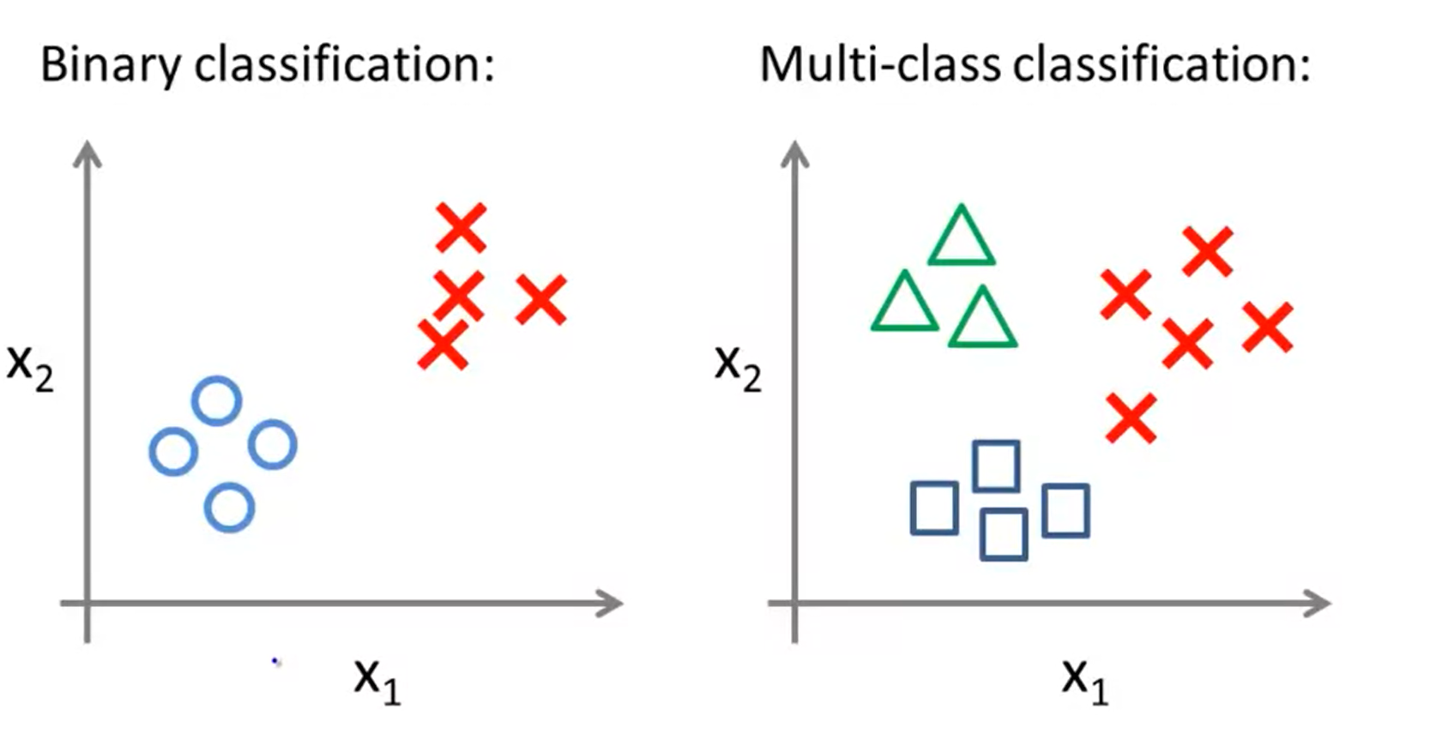
Session 4
Multiclass Classification
Examples :
Emails: (Work, Friends, Family, Hobby).
Color: (Red, Green, Blue).
Weather: (Sunny, Rain, Cloudy, Snow).
Grow Through

Slide 20
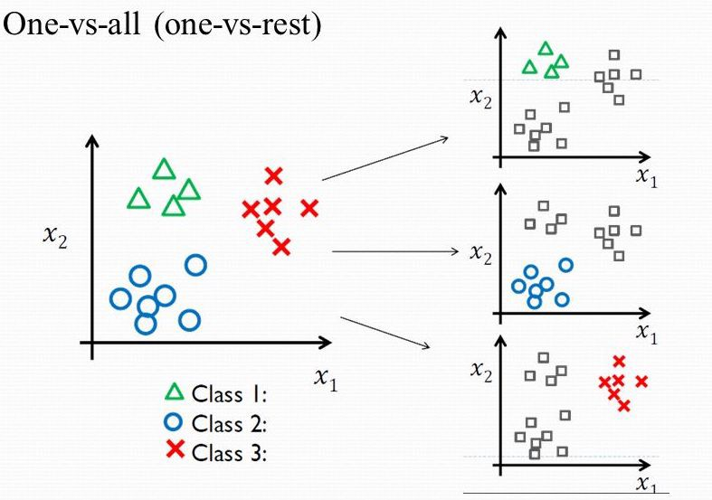

Multiclass Classification
$$h_{θ}^{(i)}\left(x\right)=P\left(y=i | x;θ\right) (i=1,2,3)$$
Grow Through

Slide 21
Goodbye
Grow Through

